Slide 1
Gobbledygook And Other Patient Package Insert Information
Tenille L. Lawson, PharmD BCPS, May 24, 2018
Indiana Chapter of the American Medical Writers Association

Slide 2
introduction

Slide 3
a LITTLE BIT ABOUT ME
Pharmacist
Wife+Mom
Freelance Medical Communicator-
The Write Script Delivers LLC ©
Notes:
On LinkedIN.

Slide 4
Objectives
Present case example that illustrates the impact of information listed in patient package inserts vs package inserts
History of the patient package insert
Plain Language
Current status of patient package inserts
Future suggestions

Slide 5
Case Example

Slide 6
Amiodarone
Loading Dose vs Maintenance Dose
Package Insert - YES
Patient Package Insert -NO
Medication Guide – NOT AVAILABLE

Slide 7
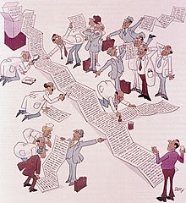

Slide 8
Patient information access before ppi availability
Manufacturer
FDA
Physician
Patient
Pharmacist: TAKE AS DIRECTED

Slide 9
WHAT STARTED THE CHANGE?

Slide 10
1968 Isoproterenol inhaler warning
Dosing causes harm in other countries
President LBJ issues a decree to add warning to medication
Must be included with every dispense
This Photo by Unknown Author is licensed under CC BY-SA
Notes:
B1 and b2 agonist. Nonselective. Heart moving. Racing. Lungs contracting. Structurally related to epinephrine. Around late 1960s, England and other countries were overdosing due to high dose. Increase in deaths. PPI required with warning.Two sentences saying do not exceed recommendations. Could be fatal. Arrythmias. Small patient population. Dailymed only lists injection as available.

Slide 11
1970 Birth control controversy
Birth Control and Women’s Rights
Birth Control and Physician Rights
Birth Control and FDA / Pres. Nixon
Birth Control and Manufacturers
Birth Control and Pharmacists
Notes:
June 11th FDA Order issued. Sept 10th NY Times reported 150 word package insert that warns of side effects included in PPI for 8.5 million women. In addition, doctors had an 800 word brochure written by the Amer Med Association that patients may have a copy of with the doctors permission and distribution. BC’s increased blood clotting disorders.

Slide 12
How did we get here?

Slide 13
The major participants 1970
Patient
Full Disclosure?
Manufacturer
Responsibility
Cost
Pharmacist
FDA
Physician
Informed Consent
Right to Choose
Authority
FDA Favor
Clear FDA Direction
Women’s Rights
Physician Patient Relationship
Manufacturers + Learned Intermediary
President
Compliance
Verbal Counseling
Cost and Labor to Distribute
Reimbursement
Liability
Sales
Notes:
Labeling is for physicians. OTC label is for consumers. Patient education? Right to know documents? Decision making information? Is this scary or helpful? Is this similar to asking a surgeon to show you the cutting utensils and explain each one prior to completing the procedure? Communication Gaps exist?
Women’s Rights Movement – Listen to us now!
Authority – Physician and Pharmacist only
Cost and Time – Drug Manufacturers and Pharmacists
Compliance – Will patients take it if they know more? Well Yes and No
Cause more harm than good – What patients need to know, I, doctor will tell them
Length of information – Disclose, well, everything? How should it be written?

Slide 14
1990’s Plain language
No more gobbledygook!
1978 President Carter
1993 President Clinton
No Goobledygook Awards
2010 President Obama
Plainlanguage.gov
Notes:
The use of PPI’s grew into what we have today and the language used to explain the information also evolved. The request for plain language may have started with Thomas Jefferson, as long as the country has existed. John O’Hayre Gobbledygook Has Gotta Go.

Slide 15
Gobbledygook has gotta go! John o’hayre 1966
“We can’t buy words like we buy pine seedlings, or stockwater wells, so it’s as though words have no inherent value and can’t be measured in money or evaluated in terms of costs”.
Notes:
Page 90

Slide 16
Plain language defined by cdc
Organize to serve the audience
Choose words carefully
Make information easy to find
Notes:
Printouts

Slide 17
Who reads the ppi today?

Slide 18
What categories are on the current ppi?
AUDIENCE RESPONSES
MED GUIDES = BIRTH DEFECTS
USAGE INSTRUCTIONS = INHALERS
WARNINGS
USED FOR
TELL DOCTOR BEFORE TAKING
THINGS TO KNOW
CONTACT MD RIGHT AWAY
SIDE EFFECTS
HOW TO TAKE
MISSED DOSE
STORAGE
GENERAL FACTS
DO NOT FLUSH

Slide 19
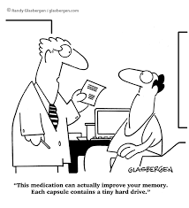
PACKAGE INSERT EXAMPLES
CIPRODEX
FEMCON FE
AMIODARONE
FLOVENT
Notes:
Printouts
Manufacturers may include PPI’s in their insert and often do. All are required to include “information to patients”section. First Data Bank and companies like it supply the PPI at Kroger. See example.

Slide 20
Amiodarone outcome
Patient’s medication was updated to reflect safe dose
Patient was contacted to explain change and to assist with questions
Patient was advised to speak with pharmacist and physician before next refill

Slide 21
Where are we now?

Slide 22
Progression of patient information access
MANUFACTURER
FDA
PHYSICIAN
PHARMACIST
INTERNET
PATIENT
PATIENT
PATIENT
PATIENT
Notes:
Can walk up to RPH and ask for PPI and PI like I did. Can google and get info. Can go to FDA site and get info.

Slide 23
Personal responsibility?

Slide 24
Find ouT for yourself!
Internet access – YouTube, DailyMed, FDA.Drugs, WebMD
Call manufacturer directly
Call FDA
Must read Medication Guide
Read Package Insert
Read Patient Package Insert
Ask MD questions – Personal Responsibility
Ask Pharmacist to counsel
Read Magazines, Newspapers, watch Doctor Oz
Stay Informed

Slide 25
HOW IS IT AVAILABLE?
Every package mail order or local pharmacy
Languages and Translations
FDA phone # for ADR’s
Contact your Doctor for more info
First Data Bank, Wolters Kluwer

Slide 26
Where do we find it?

Slide 27
We have come pretty far but…

Slide 28
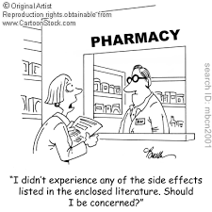
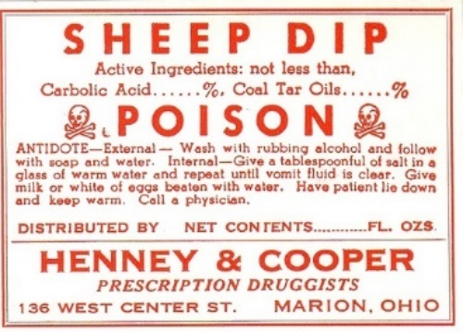
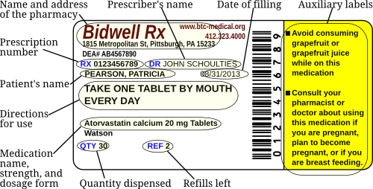
Are we there yet?
This Photo by Unknown Author is licensed under CC BY
This Photo by Unknown Author is licensed under CC BY

Slide 29
2020 communication? Emoticons please!

Slide 30
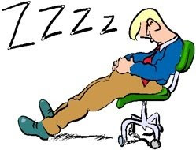
Just pictures for millennials?
Take with Food
This Photo by Unknown Author is licensed under CC BY-NC-ND
This Photo by Unknown Author is licensed under CC BY-NC
This Photo by Unknown Author is licensed under CC BY-NC-SA
This Photo by Unknown Author is licensed under CC BY-NC-SA

Slide 31
In my perfect world…
Today
tomorrow
Storage
Side Effects
Administration
How much sun? Is having sunscreen enough? TCN
How dizzy? Can I drive? Ambien sleepdriving
How much food? Jakafi small meals. With, After, Before? Does it matter? Absorption/Effective, Stomach aches, Overdose?
How cold? Neupogen
What is room temp? Lupron
How many days out before not good? Insulin
Is rash normal? What to do about it? Tarceva
Red -911, Yellow – Next MD appt/Proceed with caution, Green - Normal
Notes:
Someone may not see md for 90 days or only speak with an MA who is unfamiliar with the diagnosis or medication.

Slide 32
QUESTIONS???

Slide 33
Amwa membership
hoosieramwa.org/chapter-podcasts

